Slide 1
The Compilation Power – C++
Basic Knowledge
Compilation is the stage which makes your code executable. It is the translation process, done by the compiler, from your coding language to a machine language (aka binary.)
Note: For this presentation I’ll use the Gnu Compilers Collection compiler (aka GCC.)

Slide 2
C++ Metaprogramming
Templates (Type / Value arguments.)
Template Argument Restrictions:
Template-template.
Typename restrictions.
Requires (Since C++20)
Concepts (Since C++20)
Constexpr (Since C++11) & Consteval (Since C++20)
Concepts – More than just restrictions…

Slide 3
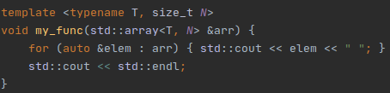
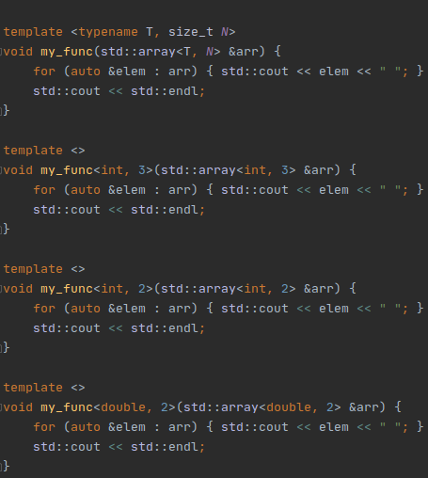
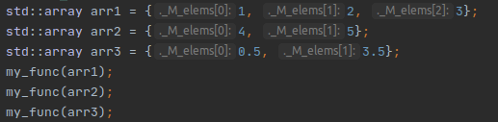
Templates Brief
Compile time auto generation for functions / classes which differed by compile time types / values parameters.
The compiler will generate the following functions for us:
// Language lawyers like me: Please ignore operator functions parsing.
With the following calls:

Slide 4
Template Argument Restrictions
Why?
Extended functionality (template-template).
Avoid developer mistakes.
- Let your code speak for itself.
- Protect your code from strangers.

Slide 5
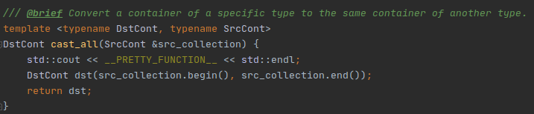

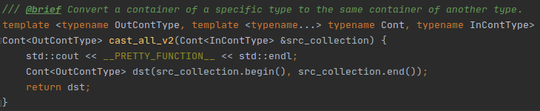

Template Argument Restrictions
Extended Functionality
With template-template we can gain an additional functionality when accessing a template-template argument.
All we want to specify on the call is the type to convert to:
The following implementation will allow us to do so:

Slide 6
Template Argument Restrictions
Typename Restrictions
Using typename restriction we can make sure on compile time to get more informative errors

Slide 7
Questions
If you have any questions, speak now or for ever hold your peace.
Or at least until you’ll be near
LinkedIn: /koralkashri
Mail: koralkashri@gmail.com
GitHub: /koralkashri
Twitter: @koralkashri

